Slide 1
School of Computer Science Engineering and Information Systems
Fall Semester 2024-2025
Department of Computer Applications
PMCA698J – Dissertation -1 / Internship -1
Review -1
ADVANCED CLASSIFICATION OF COCONUT TREE DISEASES USING A DEEP STACKING ENSEMBLE APPROACH
by MADHAVAN.P (23MCA0385)
Under the Guidance of
Dr. Swarna Priya R.M

Slide 2
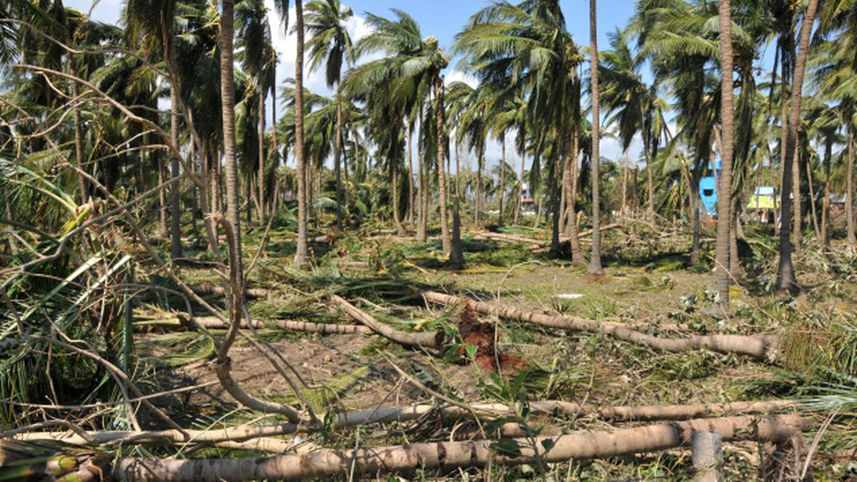

ABSTRACT:
Coconut trees are vital to tropical agriculture but are prone to diseases that can harm yields and plantations. This research presents the Deep Stacking Ensemble Model (DSEM), a novel approach for enhancing disease detection in coconut trees. Using a dataset of 5,798 images, DSEM integrates multiple deep learning techniques to boost detection accuracy and reliability. The study also compares the optimization algorithms Adam and SGD, finding that while Adam speeds up learning, SGD improves performance in certain cases. Overall, DSEM outperforms traditional methods, offering a powerful model for early disease detection and sustainable coconut farming.
Keywords: coconut tree,Deep Stacking Ensemble Model (DSEM), deep learning, disease detection, optimization algorithms, Adam, Stochastic Gradient Descent (SGD).

Slide 3
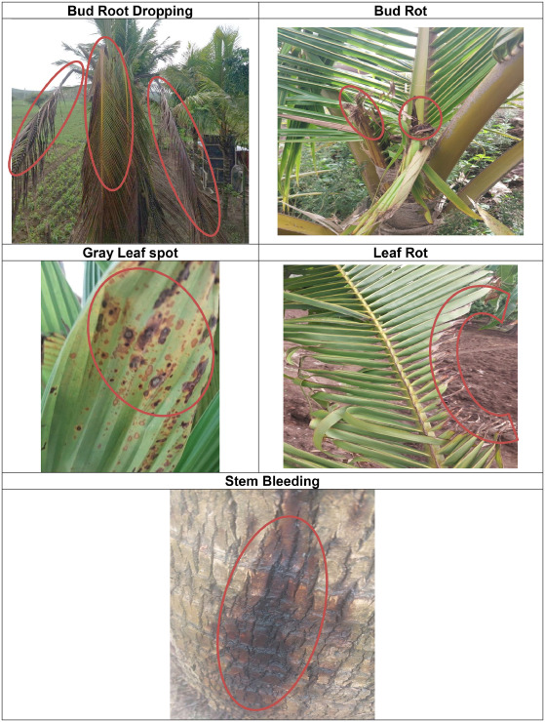
INTRODUCTION:
Coconut trees (Cocos nucifera) are vital to tropical agriculture but are susceptible to diseases that can harm yields and threaten farmers' livelihoods. Existing detection methods, often time-consuming and prone to errors, are increasingly impractical. This study introduces the Deep Stacking Multi-Layer Model (DSEM), integrating EfficientNet B3 and ResNet50 V2 to improve disease detection accuracy. Using a dataset of 5,798 images, the DSEM focuses on detecting five key diseases: Bud Root Dropping, Bud Rot, Gray Leaf Spot, Leaf Rot, and Stem Bleeding. This approach offers a more effective solution for early disease identification and management, promoting sustainable coconut farming.

Slide 4

PROBLEM STATEMENT:
The primary problem addressed by this project is the accurate and efficient classification of coconut tree diseases from images. Current methods for disease identification are often hindered by limitations in accuracy, speed, and scalability, especially when handling large datasets. The challenge is to develop a deep learning model capable of reliably identifying and classifying multiple diseases, including “Bud Root Dropping,” “Bud Rot,” “Gray Leaf Spot,” “Leaf Rot,” and “Stem Bleeding,” based on visual data. By leveraging advanced deep learning techniques, this project aims to enhance the precision and efficiency of disease classification, facilitating timely intervention and improved management practices in coconut plantations.

Slide 5

OBJECTIVES:
To classify coconut tree diseases based on pattern recognition using computer vision and deep learning algorithms. By accurately identifying the specific disease affecting coconut trees, we aim to determine the severity of infection, assess potential yield loss, and recommend necessary intervention measures. We propose a model for the morphological classification of coconut tree diseases into five categories: 'Bud Root Dropping,' 'Bud Rot,' 'Gray Leaf Spot,' 'Leaf Rot,' and 'Stem Bleeding.' This model will analyze disease patterns and characteristics, providing valuable insights for early detection and effective management, thereby supporting sustainable coconut farming.

Slide 6

SCOPE OF THE PROJECT:
This project involves developing a deep learning model for classifying coconut tree diseases into five categories: 'Bud Root Dropping,' 'Bud Rot,' 'Gray Leaf Spot,' 'Leaf Rot,' and 'Stem Bleeding.’
The scope includes:
Training Time Calculation: Evaluating and optimizing the time required to train the model to ensure efficient use of computational resources.
Addressing Overfitting: Implementing strategies to mitigate overfitting, such as regularization techniques and cross-validation, to improve model generalization to unseen data.
Optimizer Usage: Employing Adam and SGD optimizers to enhance model performance and convergence during training.

Slide 7
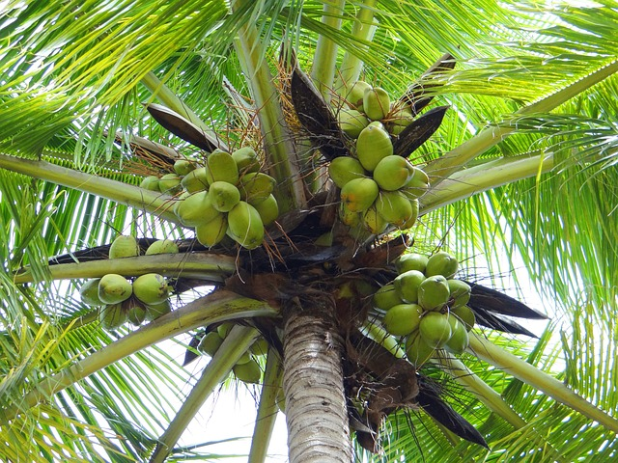
PROPOSED SYSTEM:
The proposed system for coconut tree disease classification uses a Deep Stacking Ensemble Model (DSEM) that integrates features from EfficientNet B3 and ResNet50 V2. The process begins with input images that undergo data augmentation and normalization. Features are extracted separately by EfficientNet B3 and ResNet50 V2, and then combined into a comprehensive feature set. This feature set is fed into the DSEM, which uses logistic regression models with L2 regularization and dynamic learning rates to classify the diseases. The system is evaluated using metrics like the confusion matrix, ROC curve to ensure high accuracy and reliability in disease detection.

Slide 8

LITERATURE SURVEY:
S.NO | TITLE | MERITS | DEMERITS
1 | Coconut (Cocos nucifera) Tree Disease Dataset: A Dataset for Disease Detection and Classification for Machine Learning Applications (2023) | This paper introduces a system where the dataset enables high-performance deep learning models, such as ResNet50, which achieved 94% accuracy, a precision of 92.25%, recall of 93.42%, and an F1 score of 93.88%, indicating strong model performance in disease detection. | This paper needs careful model handling, as despite high accuracy and performance metrics, overfitting remains a concern, requiring attention to ensure the models generalize well to unseen data in real-world applications.
2 | Disease Identification Using Deep Learning Techniques (2024) | This paper introduces a system where the deep learning-based approach accurately identifies coconut tree diseases, aiding in early diagnosis and effective disease management. | This paper needs a high-quality dataset, as the system’s performance depends on the quality and diversity of the dataset used for training and testing.

Slide 9
S.NO | TITLE | MERITS | DEMERITS
3 | Deep Learning-Based Coconut Tree Leaf Disease Detection and Classification for Precision Farming (2023) | This paper introduces a system where the MConvnextV2 model with Swin optimizer achieves 99% accuracy in classifying coconut leaf diseases, improving disease detection. | This paper needs significant resources, as implementing and optimizing advanced deep learning models like MConvnextV2 can be complex and resource-intensive.
4 | Multi-class Classification of Coconut Leaf Disease using Fine-tuned ResNet50 Model (2024) | This paper introduces a system where the ResNet50 model accurately classifies coconut leaf diseases with up to 98.7% (epochs=40) accuracy using the Adam optimizer. | This paper needs careful model tuning, as fewer training epochs (like 10) result in less accurate outcomes.

Slide 10
S.NO | TITLE | MERITS | DEMERITS
5 | An Intelligent Deep Convolutional Neural Network for Classification of Coconut Leaf Disease (2023) | This paper introduces a system where the CNN model achieves nearly 99% accuracy in classifying coconut leaf diseases, thereby enhancing early detection and productivity. | This paper needs extensive data collection, but gathering data at various stages of disease in coconut plantations is difficult.
6 | Disease Prediction in Coconut Leaves using Deep Learning (2023) | This paper introduces a system where DenseNet-121 achieves high accuracy (around 99%) in identifying coconut leaf diseases by enhancing the learning of features. | This paper needs a diverse dataset, but gathering varied data of coconut leaves at different stages of disease is challenging, potentially affecting the model’s performance in varied conditions.

Slide 11
S.NO | TITLE | MERITS | DEMERITS
7 | Identifying The Coconut Leaf Disease Using Deep Transfer Learning Approach (2024) | This paper introduces a system where the ResNet50 model achieves 99.36% accuracy in detecting coconut leaf diseases, aiding in boosting production. | This paper needs a large and diverse dataset, but collecting such a dataset for accurate model training is challenging.
8 | Coconut Disease Prediction System Using Image Processing and Deep Learning Techniques (2020) | This paper introduces a system where the Cubic SVM classification achieved 97.3% accuracy in detecting coconut leaf diseases, improving yield and reducing losses. | This paper needs straightforward implementation, but the method relies on complex image processing steps, which may be challenging to execute in some settings.

Slide 12
SYSTEM ARCHITECTURE:
Stem Bleeding
Feature Extraction
Model 1: EfficientNet B3
Bud Rot
DSEM
DSEM classifier (Logistic Regression)
Input image
Feature Combination (Concatenation of Features)
Leaf Rot
Data Preprocessing
Gray Leaf Spot
Feature Extraction
Model 2: Resnet50 v2
Bud Root Dropping

Slide 13

REFERENCES:
[1] S. Thite, Y. Suryawanshi, K. Patil, and P. Chumchu, "Coconut (Cocos nucifera) tree disease dataset: A dataset for disease detection and classification for machine learning applications," Data Brief, vol. 51, pp. 109690, Dec. 2023.
[2] H. T. R. Wijesekara, S. A. C. Perera, D. Bandupriya, M. K. Meegahakumbura, and L. Perera, "Detection of Weligama Coconut Leaf Wilt Disease Phytoplasma by Real-Time Polymerase Chain Reaction," CORD, vol. 36, pp. 11-15, Dec. 2020.
[3] C. Kanatiwela-de Silva et al., "Immunological detection of the Weligama coconut leaf wilt disease associated phytoplasma: Development and validation of a polyclonal antibody based indirect ELISA," PLoS One, vol. 14, no. 4, pp. e0214983, Apr. 2019.
[4] M. V. Appalanaidu and G. Kumaravelan, "Plant Leaf Disease Detection and Classification Using Machine Learning Approaches: A Review," in Innovations in Computer Science and Engineering, Springer Singapore, pp. 515-525, 2021.
[5] M. A. B. Bhuiyan et al., "Characterization of Pestalotiopsis sp. causing gray leaf spot in coconut (Cocos nucifera L.) in Bangladesh," J. Basic Microbiol., vol. 61, no. 12, pp. 1085-1097, Dec. 2021.

Slide 14
[6] A. Saini, K. Guleria, and S. Sharma, "Multiclass Classification of Rice Leaf Disease Using Deep Learning Based Model," in 2023 3rd Asian Conference on Innovation in Technology (ASIANCON), pp. 1-6, Aug. 2023.
[7] S. Sharma and K. Guleria, "A systematic literature review on deep learning approaches for pneumonia detection using chest X-ray images," Multimed. Tools Appl., Aug. 2023.
[8] P. R. De Silva, C. N. Perera, B. W. Bahder, and R. N. Attanayake, "Nested PCR-Based Rapid Detection of Phytoplasma Leaf Wilt Disease of Coconut in Sri Lanka and Systemic Movement of the Pathogen," Pathogens, vol. 12, no. 2, Feb. 2023.
[9] L. G. Divyanth, P. Soni, C. M. Pareek, R. Machavaram, M. Nadimi, and J. Paliwal, "Detection of Coconut Clusters Based on Occlusion Condition Using Attention-Guided Faster R-CNN for Robotic Harvesting," Foods, vol. 11, no. 23, Dec. 2022.
[10] A. Sunpapao et al., "Morphological and Molecular Identification of Plant Pathogenic Fungi Associated with Dirty Panicle Disease in Coconuts (Cocos nucifera) in Thailand," J. Fungi (Basel), vol. 8, no. 4, Mar. 2022.

Slide 15
[11] B. Anitha and S. Santhi, "Disease Prediction in Coconut Leaves using Deep Learning," ICSCDS, Erode, India, 2023, pp. 258-264. doi:10.1109/ICSCDS56580.2023.10104940.
[12] D. Nesarajan, L. Kunalan, M. Logeswaran, S. Kasthuriarachchi, and D. Lungalage, "Coconut Disease Prediction System Using Image Processing and Deep Learning Techniques," IPAS, 2020. doi:10.1109/IPAS50080.2020.9334934.
[13] A. Kaur, V. Kukreja, N. Garg, K. Rajput, and R. Sharma, "Multi-class Classification of Coconut Leaf Disease using Fine-tuned ResNet50 Model," I2CT, 2024. doi:10.1109/I2CT61223.2024.10544047.
[14] V. Tanwar, B. Sharma, and V. Anand, "An Intelligent Deep Convolutional Neural Network for Classification of Coconut Leaf Disease," ICSC, 2023.
[15] H. H. Tuhin, M. Abdul Kayum, M. R. Kabir Rasel Sarker, S. Md Tanvir Siddiquee, and B. Pandey, "Identifying The Coconut Leaf Disease Using Deep Transfer Learning Approach," ICSC, 2024.

Slide 16
